Slide 1

Applying machine learning to student success
CORY BOYKO
NITHYA RAVI

Slide 2
Project Overview
The goal is to create a classifier to accurately predict whether a high school student passes or fails their Math or Portuguese course
Can this be predicted through students' demographics?
Are certain algorithms better at predicting success?
Is any model strong enough to practically applied?

Slide 3
Background & Related Work
Predictive analytics has been used to measure current success and predict which students need more resources to help their grades improve
Accord to EdTech, analytics can be used to help in predictive analysis, but aspects like implicit bias and privacy must always be first of mind
The US Department of Education creates a report every year on "Predictive Analytics to Improve Student Outcomes" to share results from many different analyses and one of their Future Work points is to further develop advanced analytic methods such as machine learning
In 2020, final exams in Great Britain were canceled due to COVID-19. In their place, an algorithm based on schools' and students' past results was used to create their "final" grades which led to unexpected consequences

Slide 4
Data
Binary Variables
Address – Urban or rural
Family Size – Greater or less than 3
Parent Status – Together or apart
Extra Educational Support – Yes or no
Family Emotional Support – Yes or no
Extra Paid Classes – Yes or no
Extra-curricular Activities – Yes or no
Attended Nursery School – Yes or no
Wants Higher Education – Yes or no
Internet Access – Yes or no
Romantic Relationship – Yes or no
Numeric Variables
Student Age
Mother's Education
Father's Education
Travel Time to School
Weekly Hours Studied
Past Class Failures
Quality of Family Relationships
Amount of Free Time
Go out with Friends
Weekday Alcohol Assumption
Weekend Alcohol Assumption
School Absences
G1 Grade
G2 Grade
Nominal Variables
Mother's Job
Father's Job
Reason Chose school
Guardian
Target Variable
G3 Grade

Slide 5
Portuguese
Cory Boyko

Slide 6
Preprocessing & Methods
Nominal data was first dummy coded since it did not have a natural ordering
The data was checked for outliers, but most of it is on a scale, so they didn't have any. Absences was the only unbound variable, but none were removed
The data was scaled, and separate models were run where PCA was run first (PCA did not improve accuracy)
Model evaluation was done with more preference on the predicted failed than passed, since students who fail have more consequences
Presumably, G1 and G2 occurred after some time in the course, so 3 models were used to predict whether a student passed or not based on time in the course to see how far in advance you could predict when a student would need more help
3 models: Demographics only, Demographics and G1, Demographics, G1, and G2
Methods used: Classification tree, random forests, SVM, Naïve Bayes, and KNN with 70-30 split

Slide 7
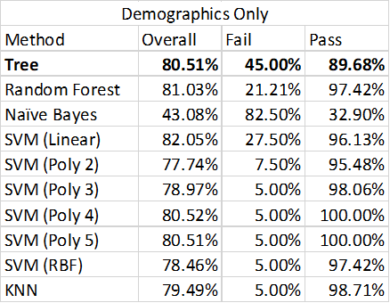
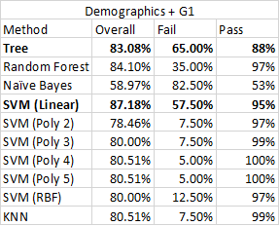
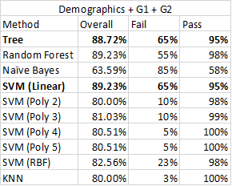
Results
Demographics Only
Demographics + G1
Demographics + G1 + G2

Slide 8
Summary
Classification trees and SVM with a linear kernel give the best results
Accuracy isn't necessarily the highest, but it maximizes the failed classification rate while maintaining a high passed classification rate
Demographics alone can predict the classes fairly well, but adding G1increases accuracy as well as G2
This allows education instructors to identify some students that may need additional support, but leaves room for improvement
Future research should focus on adding other graded assignments as demographics alone can create unexpected bias

Slide 9
Math
Nithya Ravi

Slide 10
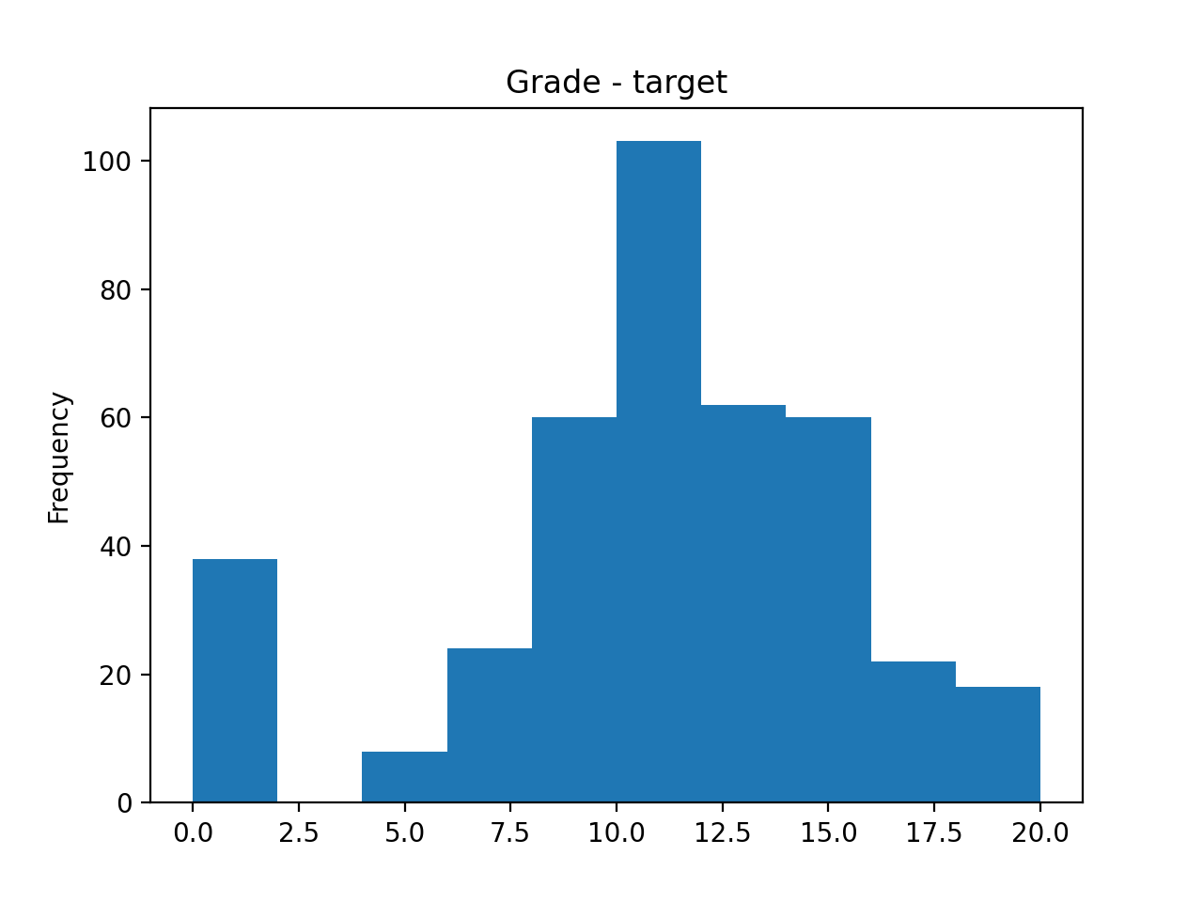
Data Description and Exploration
The math grades data has a total of 395 observations and 29 variables
Our target variable is the final grade obtained by a student
A preliminary exploration of the data was conducted to understand the relationships between the variables

Slide 11
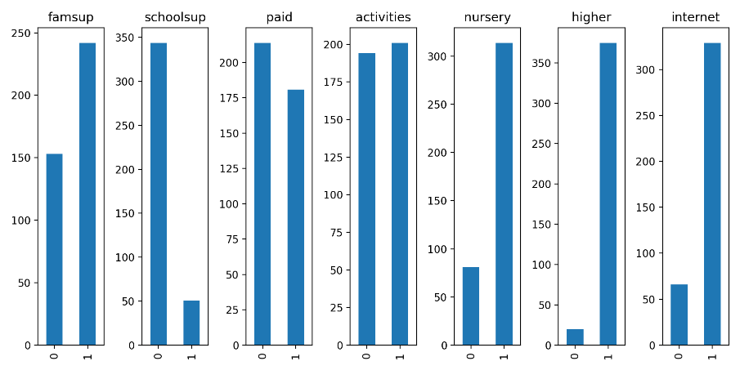
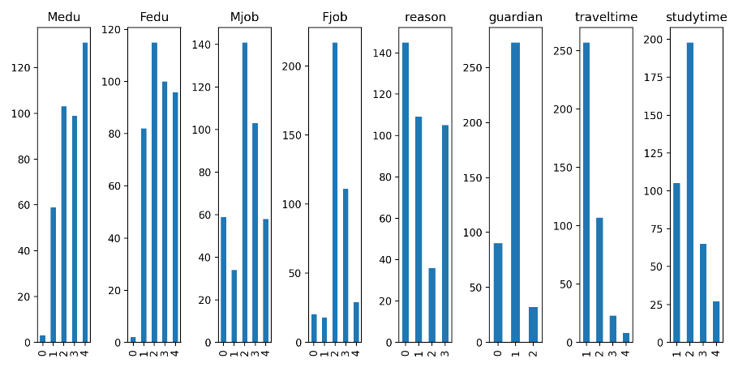
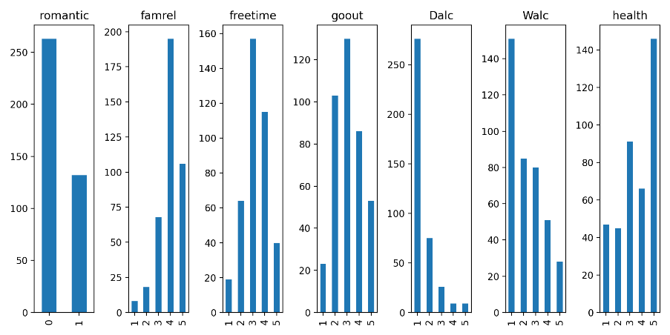
Data Exploration
Notes:
For the math dataset. it is observed that more mothers have secondary education compared to fathers while most parents are employed in Other jobs. It is also observed that more students have mother as their primary guardian. Typical travel time is less than 15 minutes from school while typical study time is 2-5 hours. While a majority of the students get family support, very few students get support from the school.

Slide 12
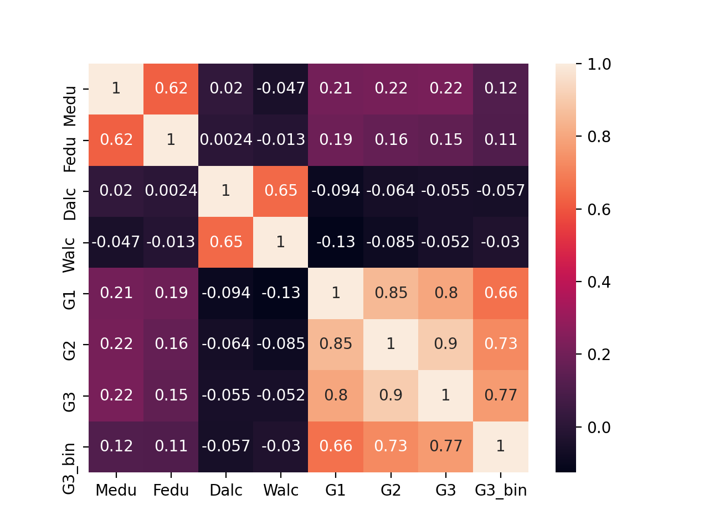
Data Exploration

Slide 13
Preprocessing & Methods
All the nominal variables were dummy coded
The math data also did not have any outliers
The data was scaled and PCA was run to determine if dimensionality could be reduced – did not have much variance
Three different models were created based on the data – one with all the variables, one with demographics, and one with only demographics and G1 grades
Here too, analysis was done not only to check for accuracy of the models but also the individual accuracies of the ability to predict the failure
Methods used: Classification tree, random forests, SVM, Naïve Bayes, and KNN with 80-20 split

Slide 14
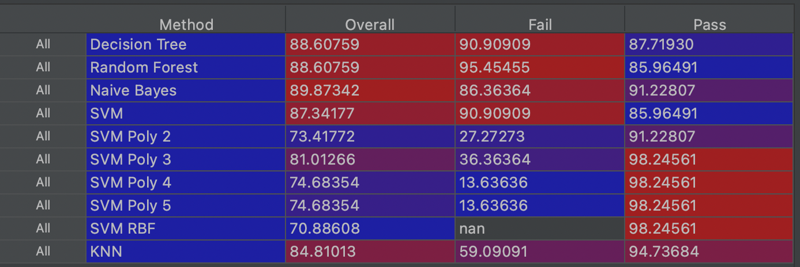
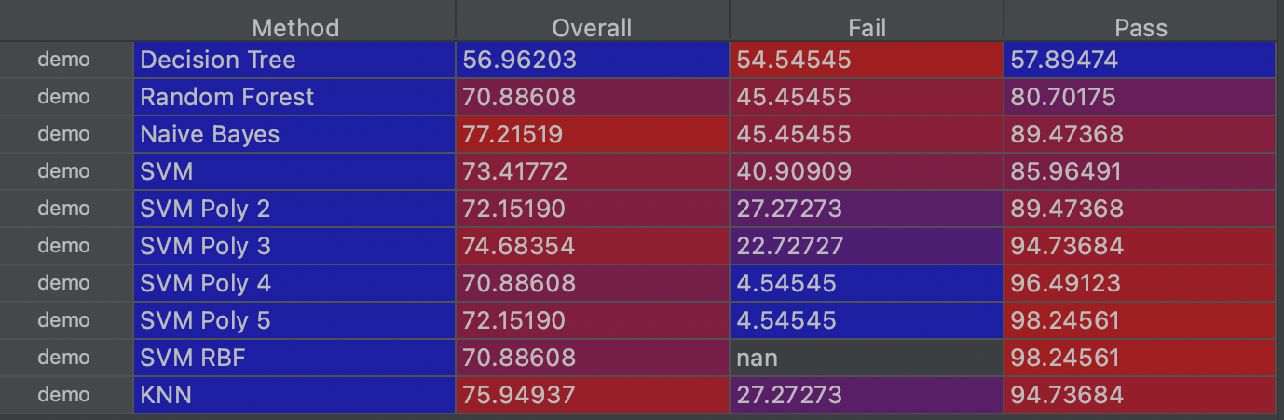
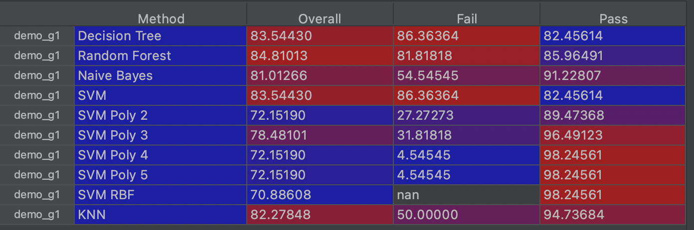
Results
We can see that the best model with the highest accuracy is the Naïve Bayes model using all the variables
The model that has the best prediction of failure is also Naïve Bayes using all the variables
The model that has the best prediction for passing is SVM with Poly kernel – this is across all 3 datasets

Slide 15
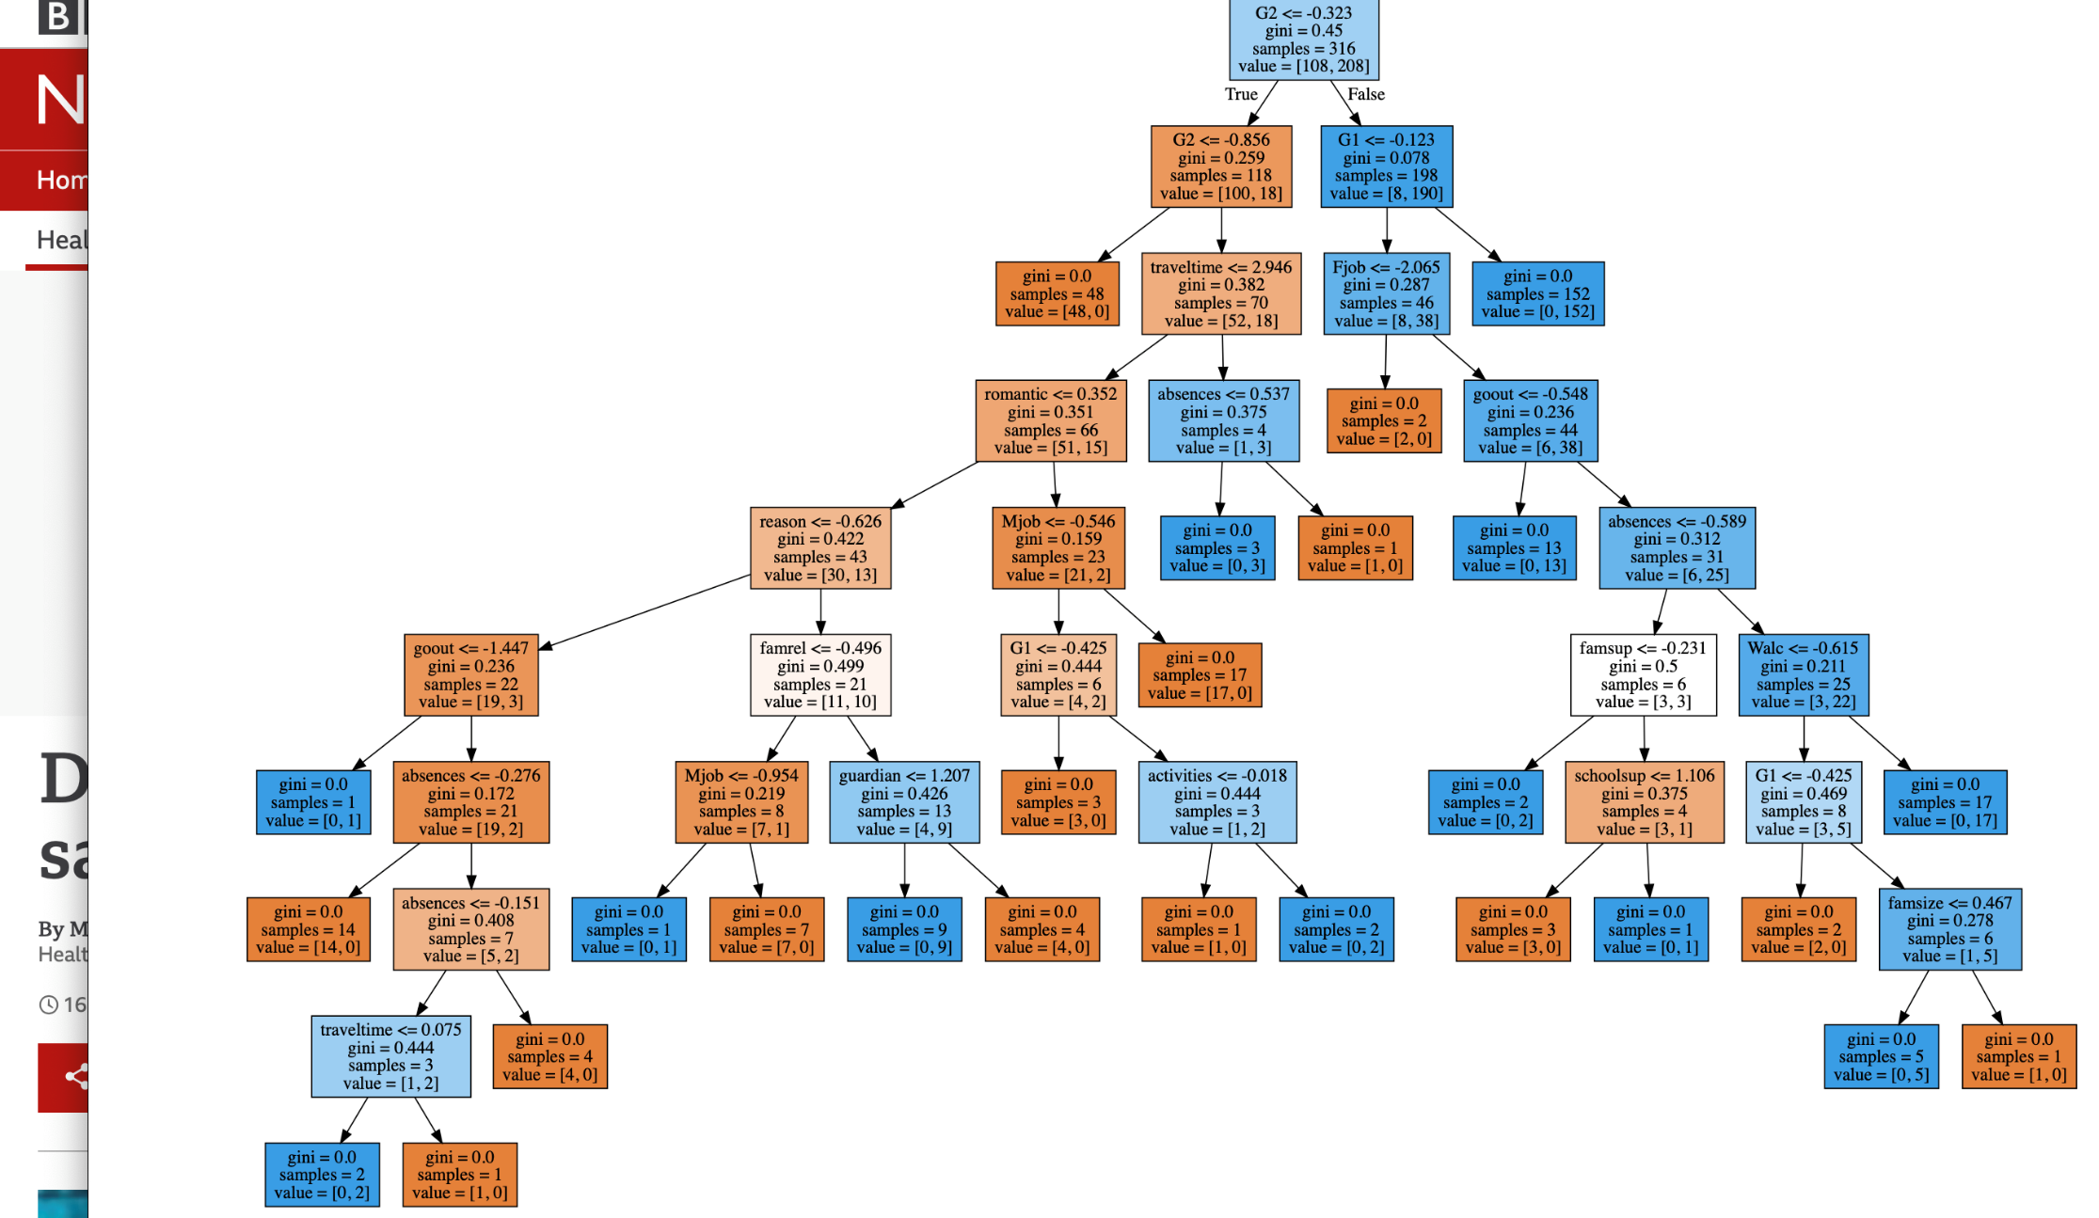
Snapshot of the Decision Tree
Starts with G2, moves on to G1 and then to demographics
Establishes what our models found – G2 and G1 add accuracy to the models

Slide 16
Summary
Naïve Bayes and SVM are the best models
The aim of the analysis is to get the highest accuracy as well as the highest prediction of failure and in both these counts – Naïve Bayes outperforms the rest
For math dataset, demographics is not a very good predictor by itself – addition of G1 and G2 significantly increase the predictive power of the models
The concern is that G1 and G2 themselves will be influenced by demographics – it is important to control for these two variables too
There is also a grade trap – once a student starts performing poorly indicated by G1 and G2, it is hard to get a good final grade
Can institutions therefore focus on remedial classes for those who are already performing poorly?
Which demographics should they focus on to identify poor performance?

Slide 17
References
Akers, K., et al. (2020, September 10). Predictive Analytics to Improve Student Outcomes (United States of America, Department of Education). Retrieved February 14, 2021, from https://www2.ed.gov/about/offices/list/ope/predictiveanalyticsslides.pdf
Clark, C. (2019, July 31). Impact of predictive analytics in higher education. Retrieved February 15, 2021, from https://www2.deloitte.com/us/en/pages/public-sector/articles/five-principles-for-improving-student-outcomes.html
Han, H. (2020, October 28). An algorithm shouldn't decide a student's future. Retrieved February 15, 2021, from https://www.hrw.org/news/2020/08/13/algorithm-shouldnt-decide-students-future
Pelletier, K. (2020, November 04). 6 best practices for using student data for student success. Retrieved February 15, 2021, from https://edtechmagazine.com/higher/article/2020/01/6-best-practices-using-student-data-student-success

